Slide 1



Exploratory Data Analysis (EDA) for Real Estate Pricing
Unveiling the Dynamics of House Valuation in a Dynamic Market
By Deewankar Sharma

Slide 2

Agenda
Problem Statement
Problem Overview
Data Acquisition and Cleaning
Univariate Analysis
Multivariate Analysis
Feature Engineering
Size Impact Analysis
Historical Pricing Trends
Customer Preferences and Amenities
Conclusion

Slide 3

Problem Statement
In the dynamic landscape of the residential real estate market, determining an optimal and competitive price for a house is a multifaceted challenge. As a key member of the analytics team in a leading real estate company, your task is to conduct a comprehensive analysis to identify and understand the myriad variables that significantly influence house prices. By leveraging advanced data analytics techniques and visualization tools, your goal is to uncover patterns, correlations, and trends within the dataset, enabling the company to make informed decisions and strategically position properties for better business opportunities.

Slide 4

Project Overview
The primary goal of this project is to analyze housing prices using a dataset containing various features related to real estate properties.
By examining factors such as size, amenities, historical trends, and feature engineering, we aim to uncover valuable insights that can aid in understanding and predicting housing prices.

Slide 5

Data Acquisition and Cleaning
Importing necessary libraries, loading the dataset, and conducting initial exploratory checks. Additionally, data cleaning is crucial to ensure data quality. This process includes handling missing values, removing duplicates, and dropping unnecessary columns that do not contribute to the analysis. By ensuring the integrity of the data, we lay the foundation for meaningful insights to be derived from further analysis.

Slide 6
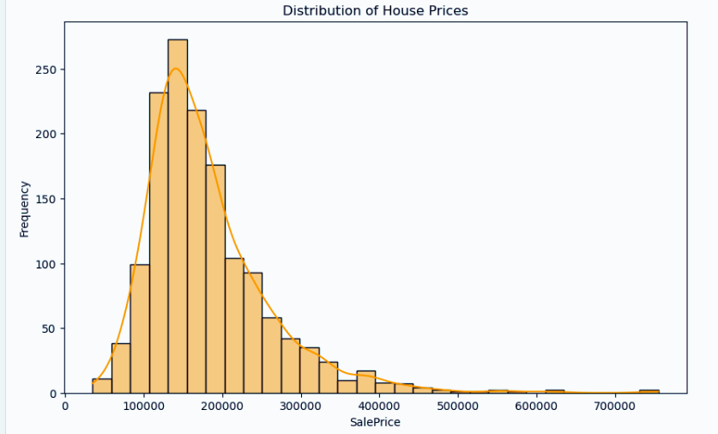
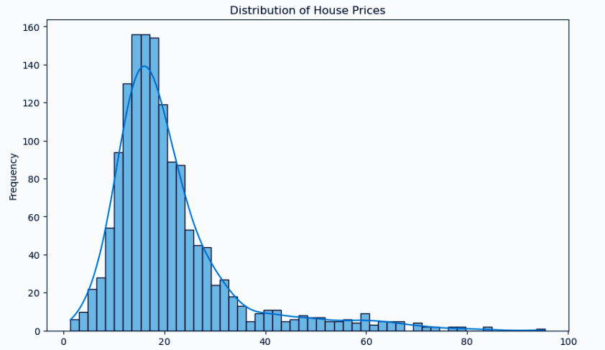
Univariate Analysis
It Focuses on exploring individual variables within the dataset to understand their distributions and characteristics. Through visualizations such as histograms and density plots, we gain insights into the distribution of key variables such as house prices and Price Per SqFt. Understanding the distribution of these variables provides essential context for subsequent analyses and helps identify potential outliers or patterns within the data.

Slide 7
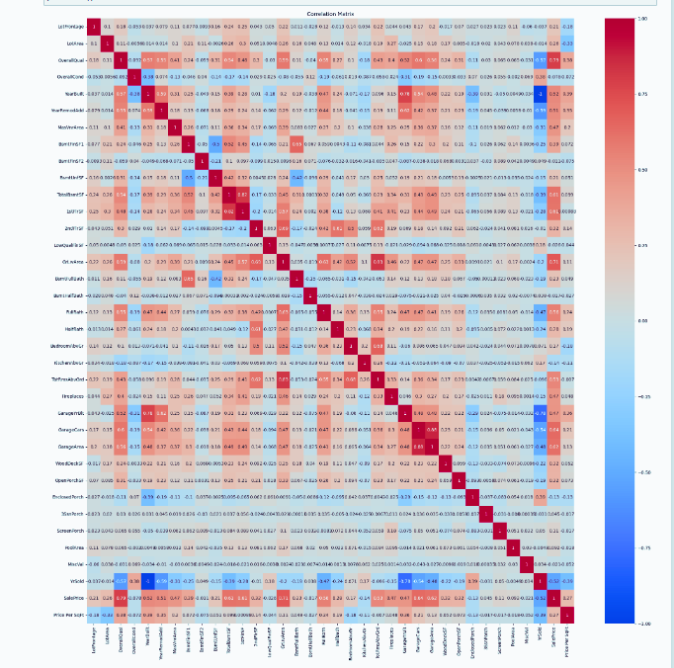
Multivariate Analysis
It delves deeper into the relationships between multiple variables, particularly those impacting house prices. By employing techniques such as correlation matrices and scatterplots, we aim to uncover dependencies and correlations between various features. This comprehensive view allows us to identify potential factors that contribute significantly to house prices and understand how they interact with one another.

Slide 8

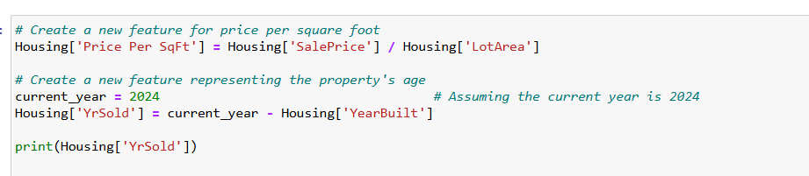

Feature Engineering
It involves creating new features or modifying existing ones to enhance the model's predictive ability. In this analysis, we introduce new variables such as Price Per SqFt and Years Since Built. Price Per SqFt normalizes house prices relative to their lot area, providing a standardized metric for price comparisons. Years Since Built captures the age of the property at the time of sale, which can influence its valuation. By incorporating these features, we aim to improve the accuracy and interpretability of our analysis.

Slide 9

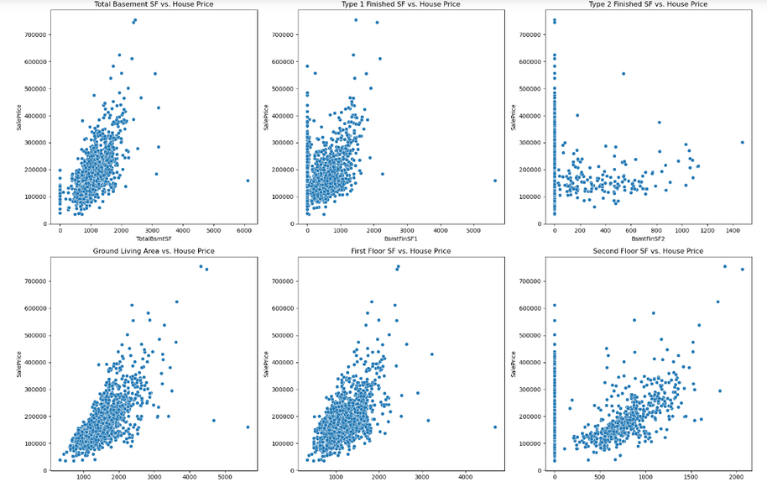
Size Impact Analysis
The size impact analysis focuses on understanding how size-related features, such as basement area and living area, affect house prices. By analyzing scatterplots, we aim to identify trends and patterns that illustrate the relationship between these features and house prices. This analysis provides insights into the value of additional space within a property and helps quantify its impact on valuation.

Slide 10

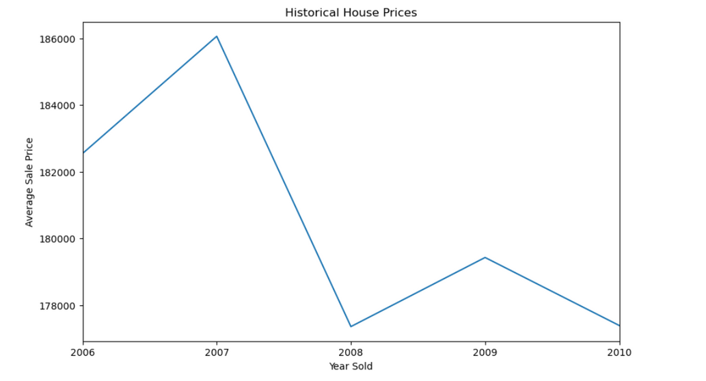
Historical Pricing Trends
Examining historical pricing trends over time provides valuable insights into market behavior and external influences. Through time-series analysis, we can identify patterns, trends, and cyclical fluctuations in house prices. Understanding these historical trends allows us to anticipate future market movements and adapt our pricing strategies accordingly.

Slide 11
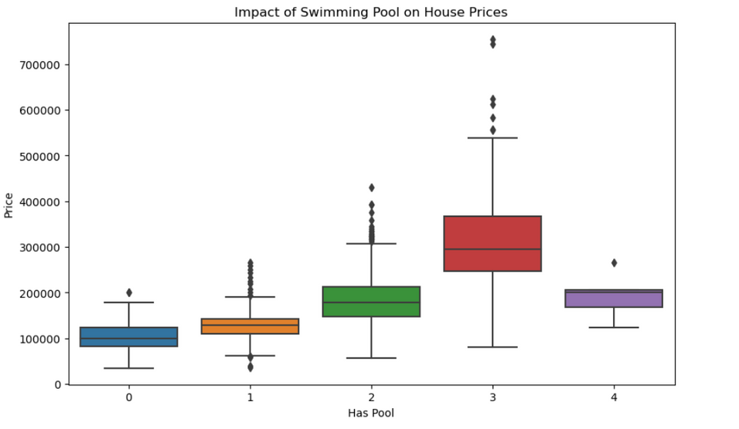
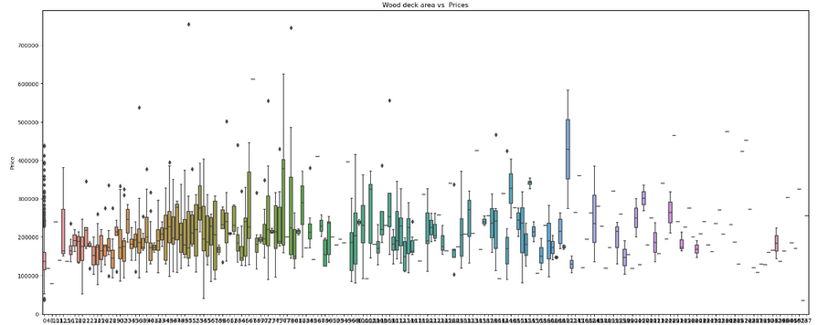
Customer Preferences and Amenities
Customer preferences and amenities play a significant role in shaping house prices. By analyzing the impact of amenities such as pools, garages, and outdoor spaces on house prices, we gain insights into buyer preferences and market demand. Additionally, examining categorical features such as heating quality and kitchen condition provides further insights into customer preferences and their influence on valuation.

Slide 12

Conclusions
In conclusion, Exploratory Data Analysis (EDA) is a foundational step in understanding the dynamics of house valuation in a dynamic real estate market. We have uncovered valuable insights into the factors influencing house prices by conducting comprehensive analyses and leveraging advanced analytics techniques. These insights can inform strategic decision-making, optimize pricing strategies, and enhance the competitive positioning of properties within the market. Continued analysis and monitoring of market trends will be essential to adapt to changing market conditions and maintain a competitive edge.

Slide 13



